Slide 1
TEPRI Energy Innovation Fund Informational Session
October 8th | 1pm
Presented by Erin Harper, Project Manager, erin@tepri.org

Slide 2
Agenda
About TEPRI and staff introductions
About the Energy Innovation Fund
Fund application process
Project examples
Session participant Q&A

Slide 3
Webinar Housekeeping
Please enter your questions in the Q&A for the TEPRI staff to answer live or afterwards via email.
If you are having technical difficulties, please type it in the chat and the TEPRI staff will try to address the issue.
This webinar will be recorded and posted to the Fund website, as well as sent to registered attendees by EOD Friday (10/9).

Slide 4

About TEPRI
TEPRI advances equitable solutions for affordable, reliable, and clean energy so all people are energy secure.
Conduct Research
Pilot Solutions
Support Energy Partners

Slide 5
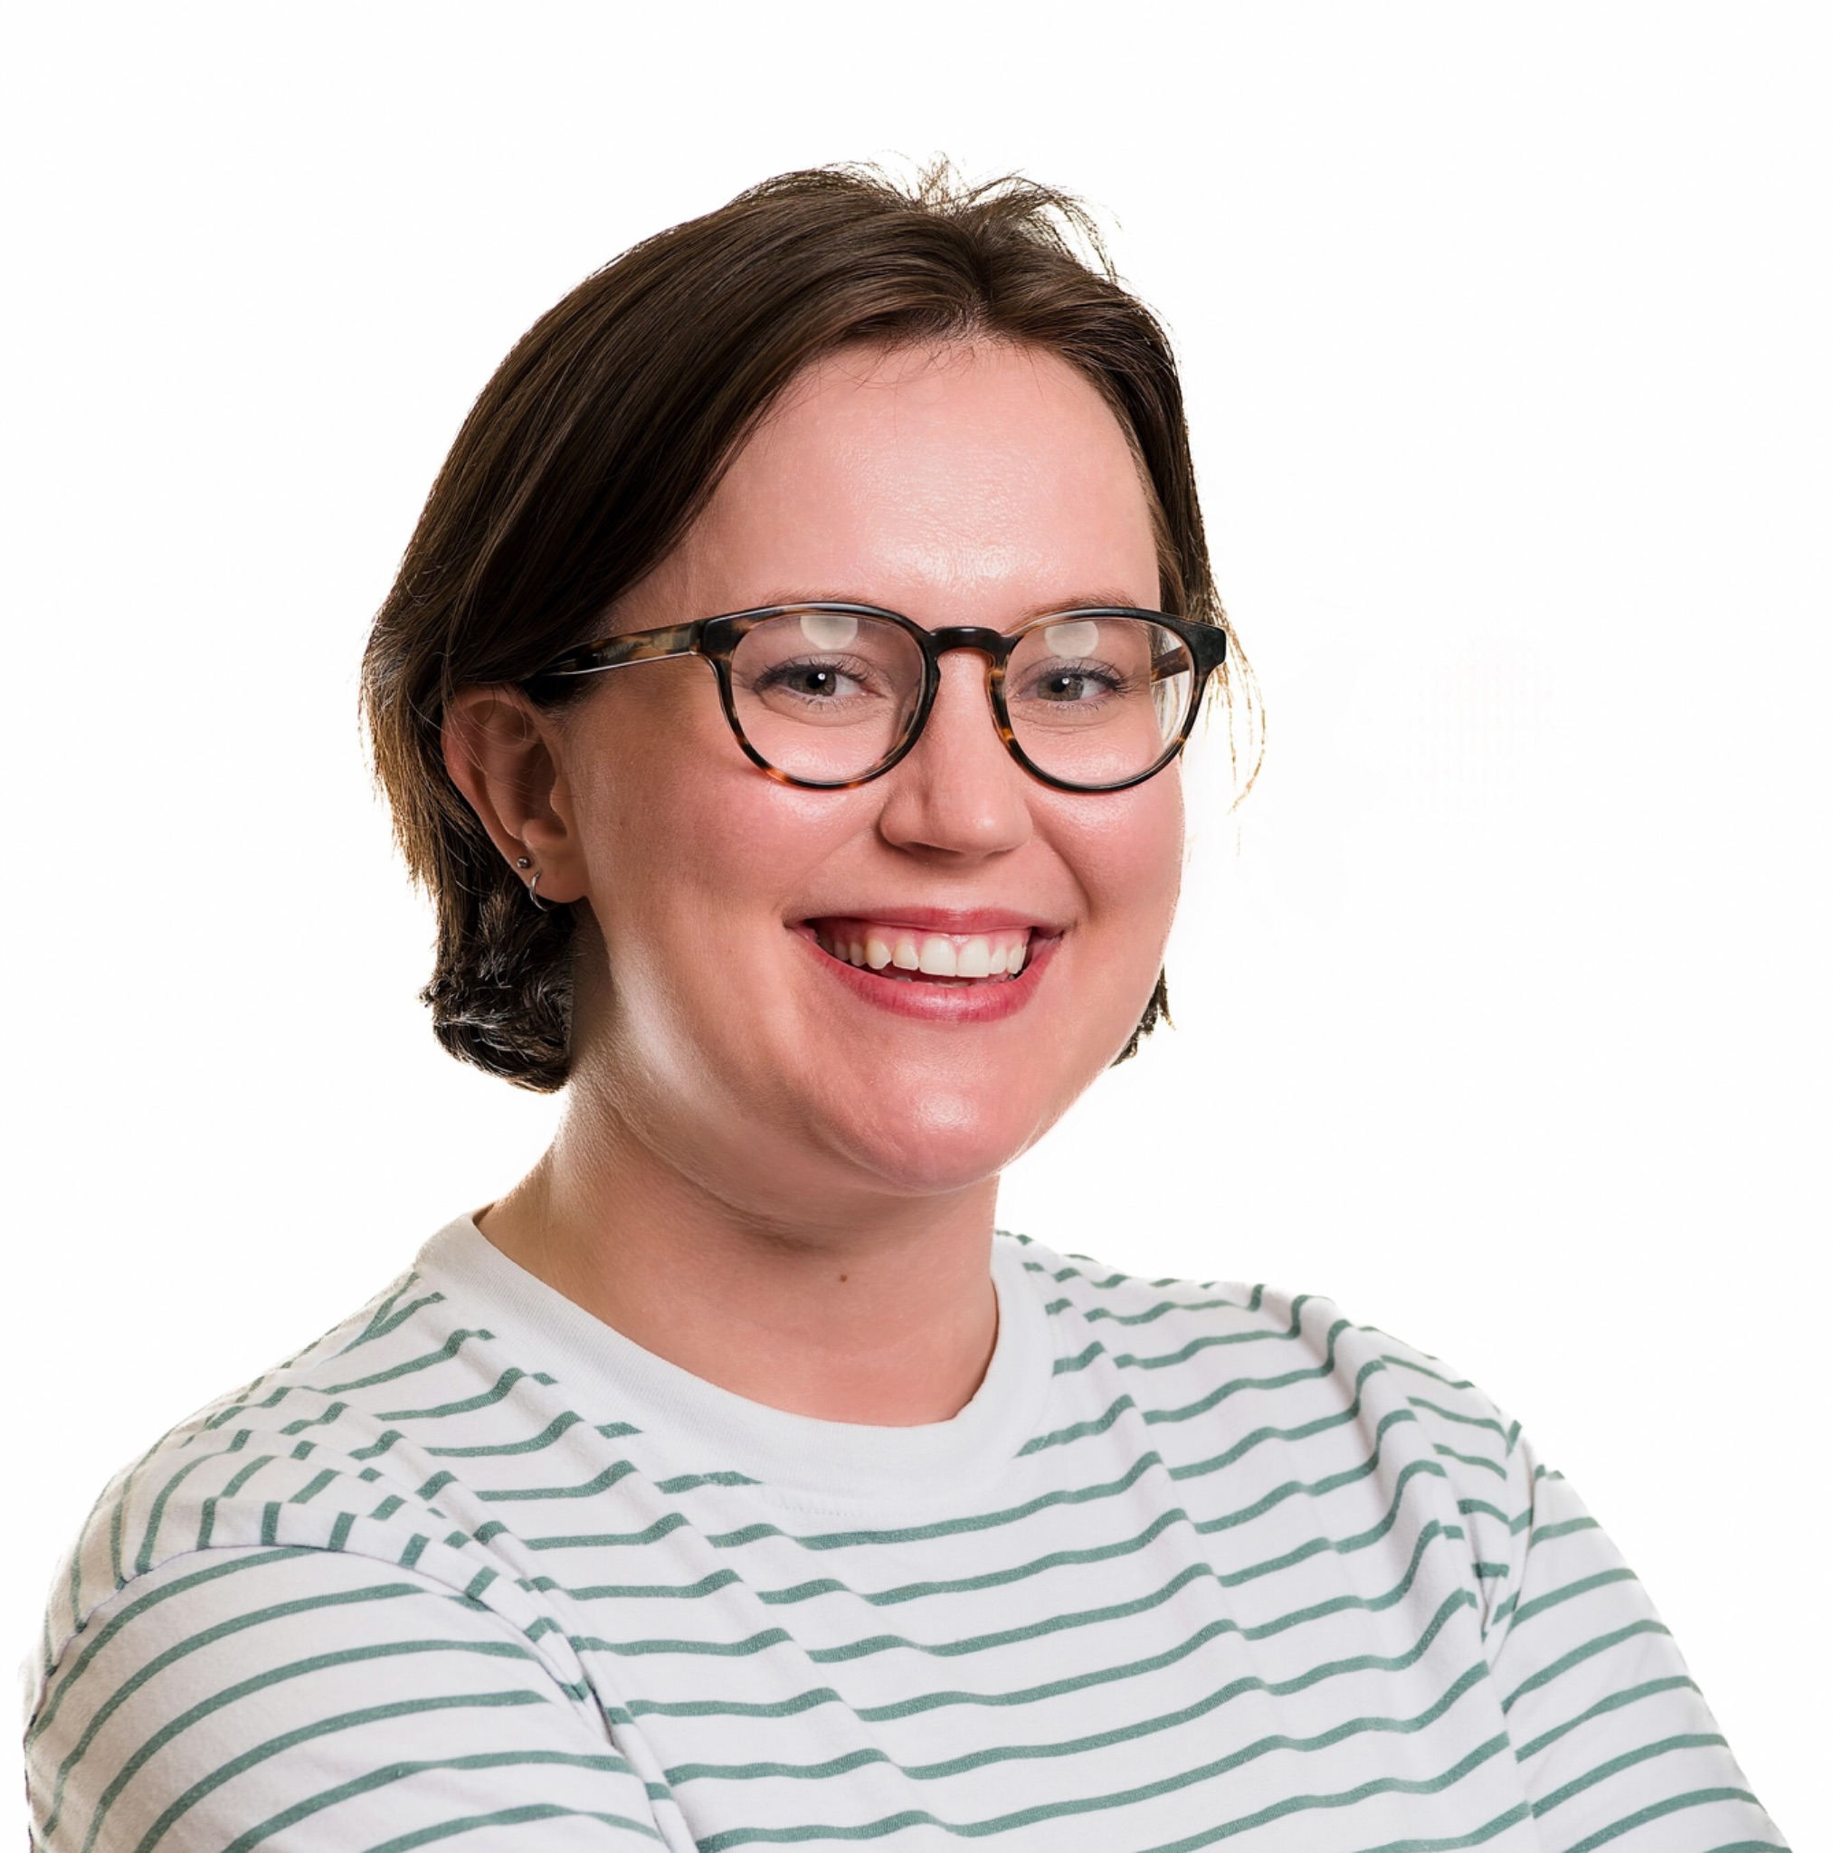
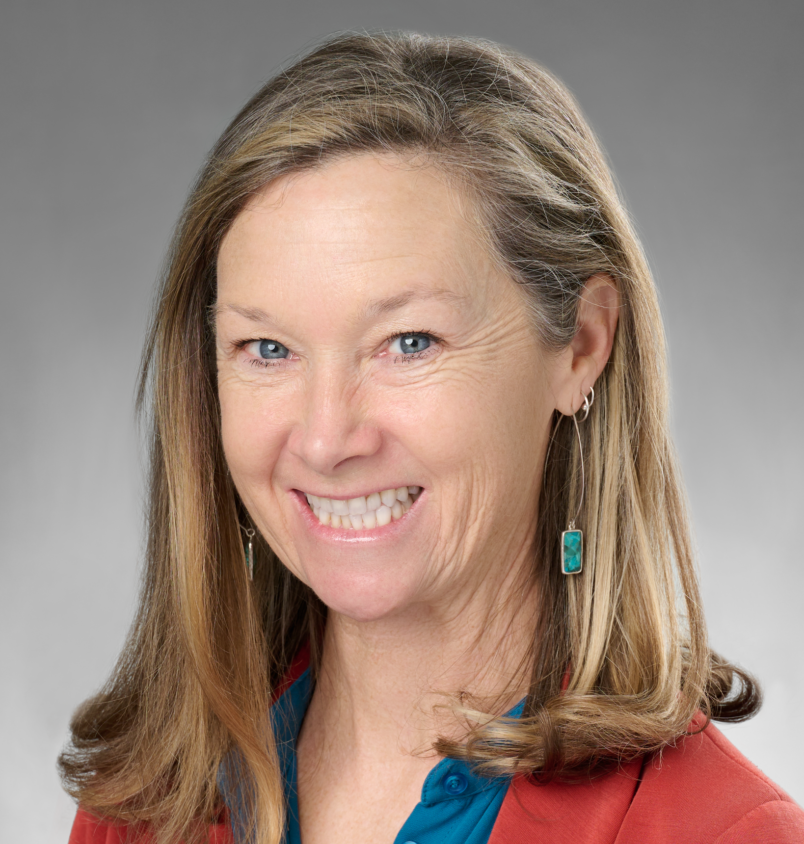
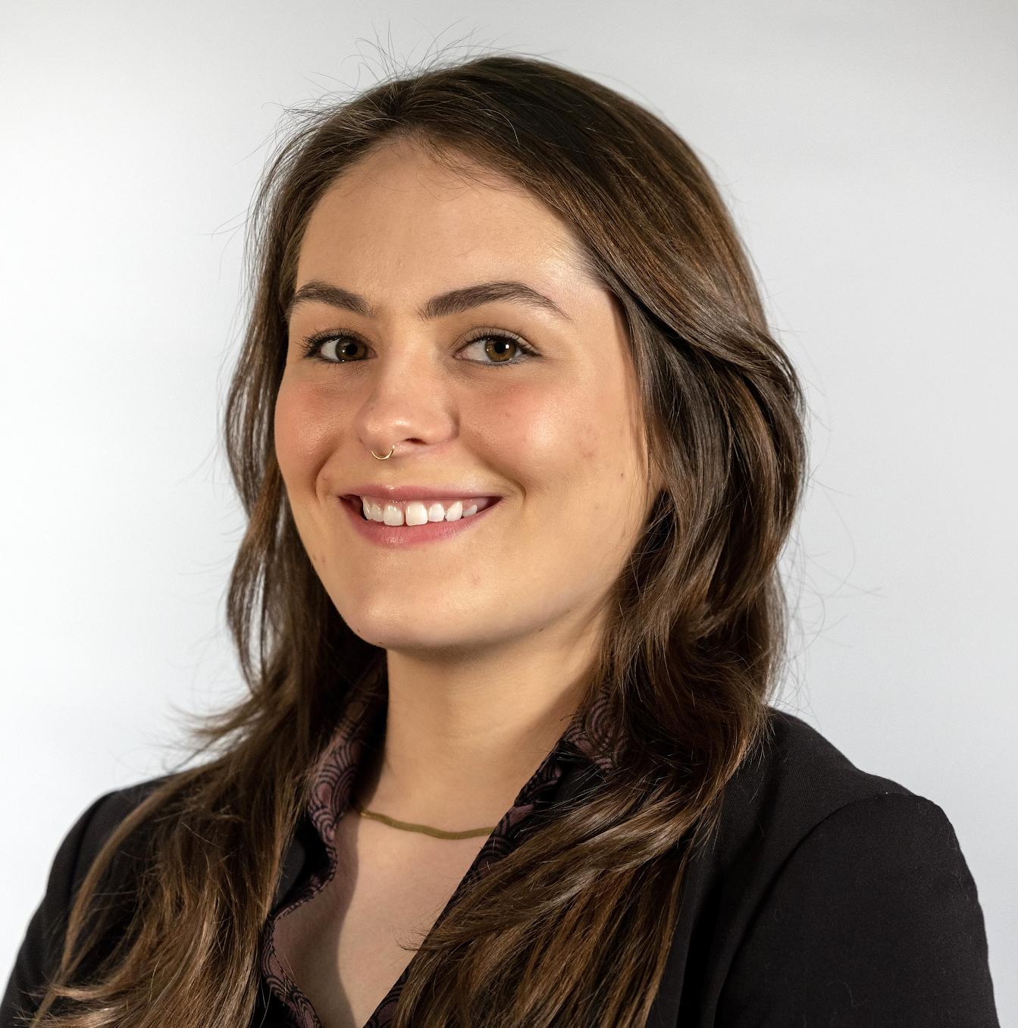
TEPRI Staff - Energy Innovation Fund
Erin Harper
Project Manager
Kathy Jack
Technical Assistance
Veronique Placke
Technical Assistance

Slide 6


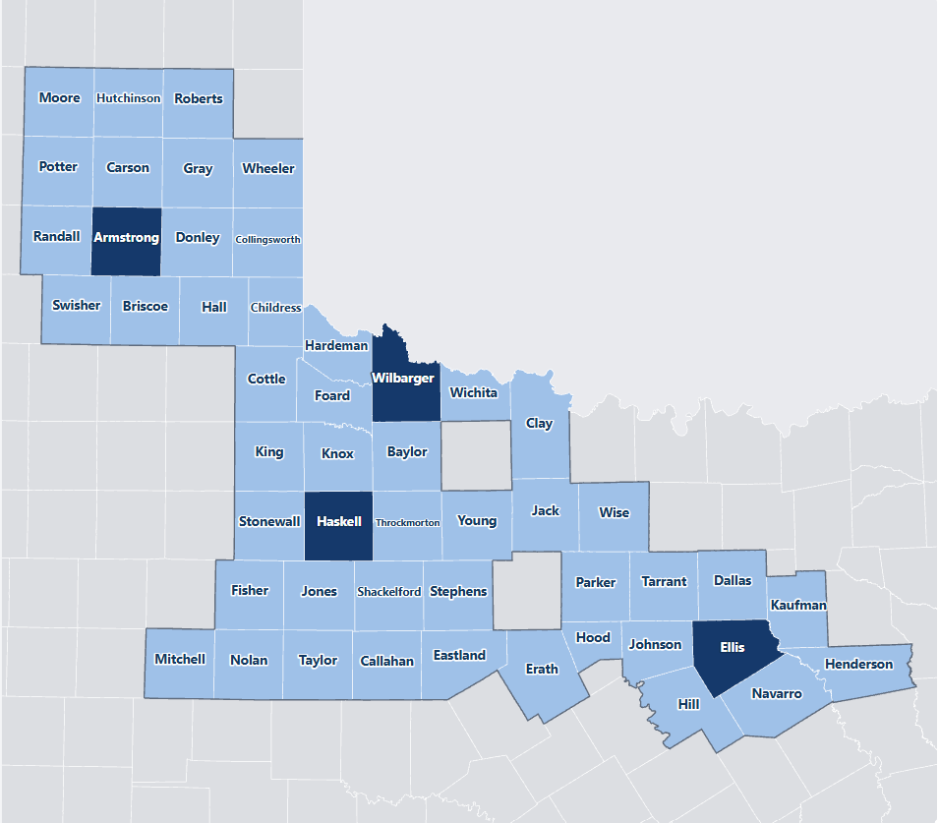
About the Energy Innovation Fund
The Energy Innovation Fund supports innovative, community-driven solutions that improve energy affordability, strengthen resilience, and build workforce capacity for low-income Texans.
Priority Geographies: Armstrong, Ellis, Haskell, and Wilbarger counties, with other surrounding eligible areas
Priority Areas: Rural Innovation & Multifamily Housing Energy Solutions
Sleepy Hollow Resilience Hub, battery storage system Holistic Energy Solutions
Notes:
Eligible organizations: non-profits, government agencies, schools, public institutions, workforce groups, municipal co-ops

Slide 7
Grant Awards and Eligible Activities
Grant awards will be between $25,000 - $250,000
Eligible Activities
Energy efficiency and weatherization, pre-weatherization and health and safety improvements, solar and BESS systems, energy workforce development programs
Award amounts depend directly on overall project scope and anticipated impact.
The Fund will be awarding a variety of project scope sizes.
Matching funds are not required but are strongly encouraged.
Non-eligible Activities
Political/lobbying activities, debt servicing, endowments, unrelated operating expenses, fundraising, regranting, and direct financial aid to individuals.

Slide 8
Fund Application Process
Apply with initial project concept on Fund Website
Receive technical assistance from TEPRI and partners, if needed
Submit full application for review
Receive notification of funding decision
1
2
3
4
TEPRI sends invitation to apply to RFP, notice to reapply, or notice of non-acceptance of project concept

Slide 9
Applications Are Evaluated on a Rolling Basis Through March 2027
September 2026
RFP Released
September 2026 – March 2027
Initial Project Concept Submission Period (Rolling Basis)
September 2026 – April 2027
Concept Review and Invitation for RFP Application
Typically a two week turnaround for concept submission and notification of invitation
October 2026 – May 2027
RFP Submission, Eligibility Review, and Funding Decisions
Funding recommendations are typically made every two months
December 2026 – May 2027
Award Notifications & Grant Agreement Execution

Slide 10
Project Concept Requirements
A one-to-two page write up of:
Community Need or Opportunity
Proposed Project or Solution
Population or Community Expected to Benefit
Alignment with Energy Innovation Fund Goals
Notes:
Community Need or Opportunity What local energy challenge or opportunity does this project address?
Proposed Project or Solution What is the project or solution you are proposing?
Population or Community Expected to Benefit Who will benefit, and how many people/households/organizations?
Alignment with Energy Innovation Fund Goals How does this project advance the Fund's goals of improving energy affordability, resilience, access to energy technologies, and/or workforce capacity?

Slide 11
Full RFP Requirements
Project Approach
Detailed project description including community need, proposed solution in detail, and how the project serves geographic areas, fund priority areas, and LMI (low-to-moderate income) communities directly and effectively.
Organizational Financial Information
Organizational structure, operating budget, and financial statements
Project Budget
A comprehensive budget detailing efficient grant use, leveraged support, and a long-term strategy for post-grant operations (if applicable).
Supporting Documentation
Proof of legal status, partnerships, site authorization

Slide 12
Tips for a Successful Grant Application
Have a direct benefit for low-income households or residents as well as priority populations
Have measurable energy savings or energy benefits for residents or organizations
Have a partnership with a local community organization
Have a targeted approach that can be deployed in 12-18 months
Show demonstrated organizational readiness to deploy the project or program as described in the proposal

Slide 13
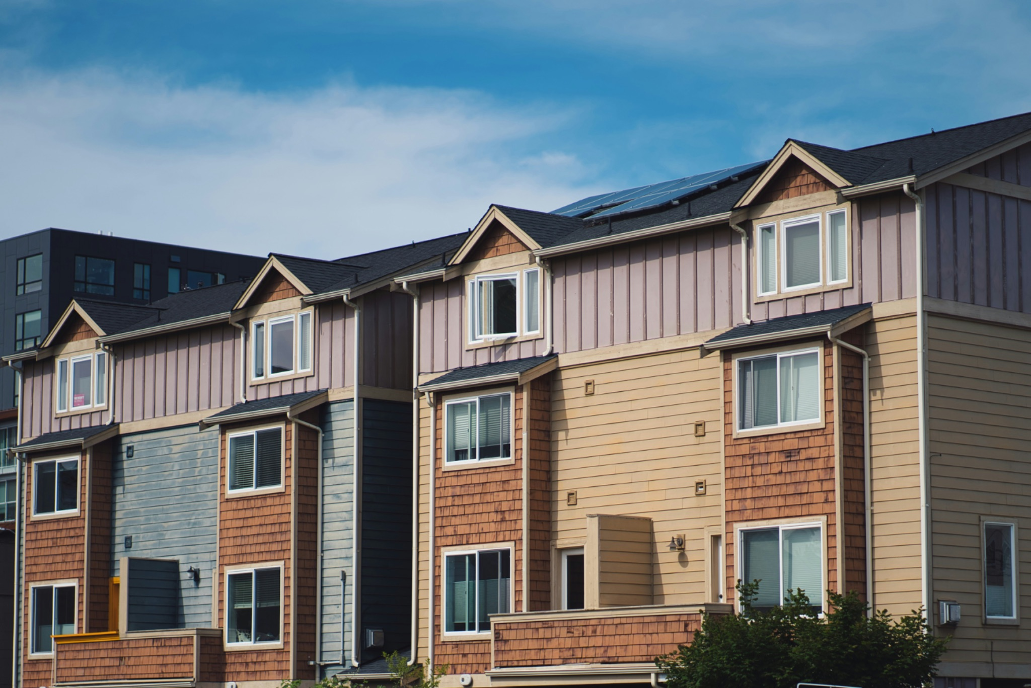
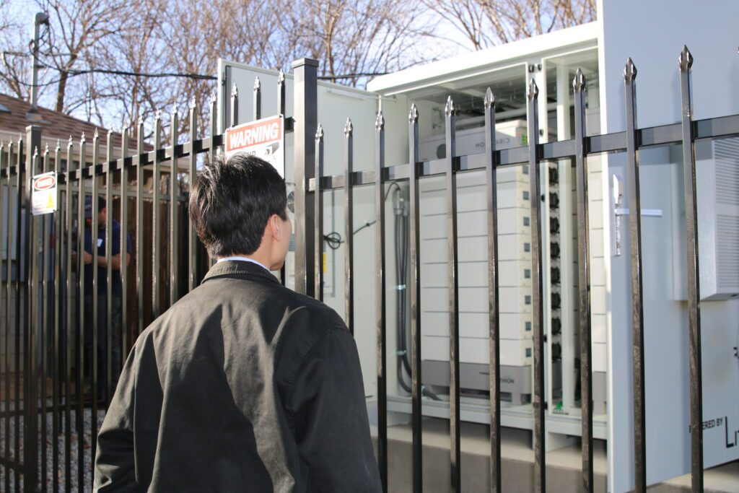
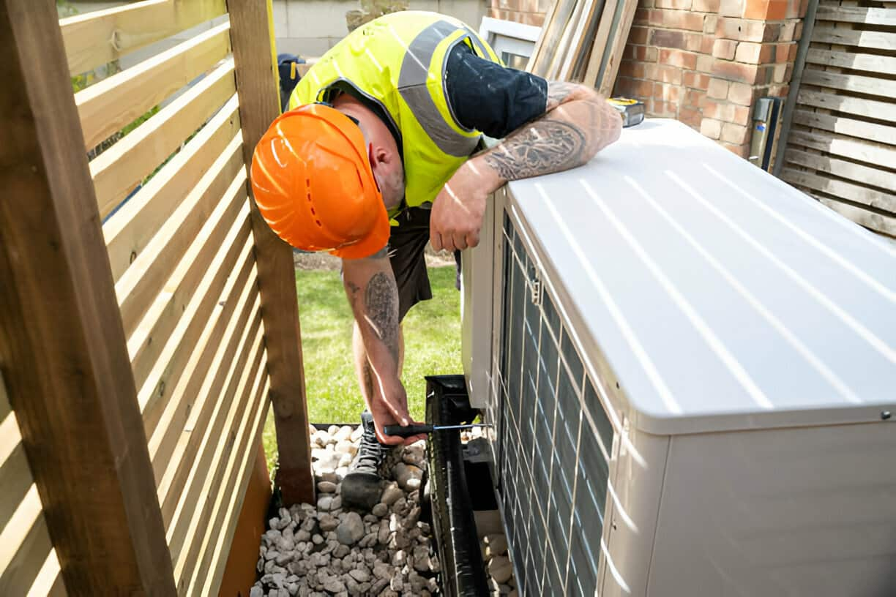
Project Examples
Residential Retrofits
Installing energy-efficient heat pumps, smart appliances, and weatherization to lower burdens for residents or tenants.
Type: Efficiency + Heat Pumps
Community Hub
A solar-plus-storage resilience facility, designed to preserve critical community services during outages.
Type: Solar + Battery
Green HVAC Training
Funding local college programs to train technicians on heat pump installation and smart grid appliance maintenance.
Type: Education + Jobs

Slide 14

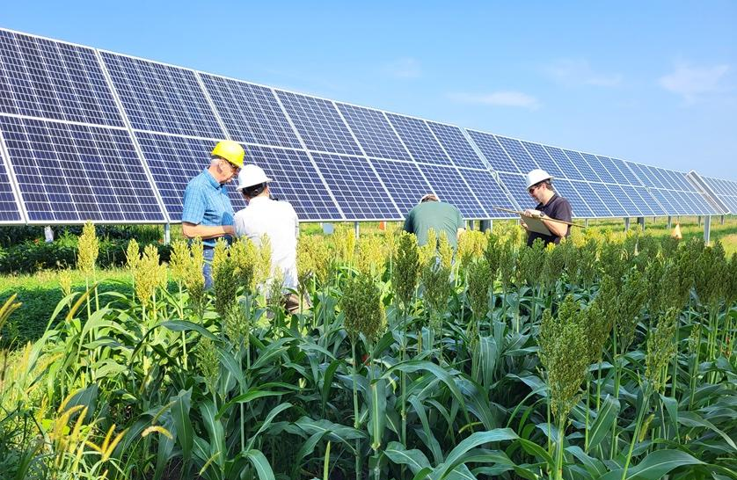
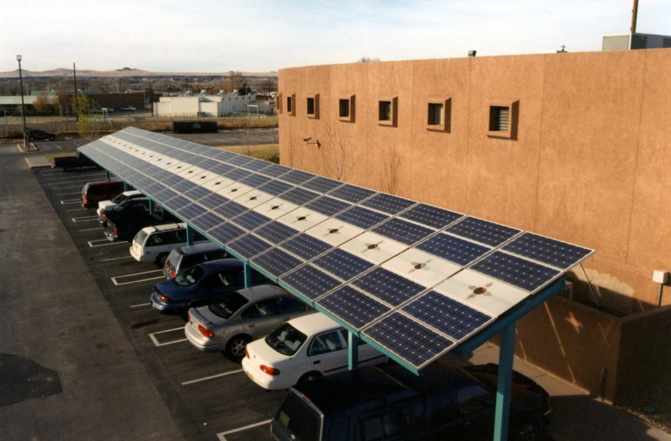
Project Examples
Rural Anchor Institution Upgrades
Upgrading facilities with high-efficiency HVAC, insulation, and clean air systems to improve wellness, increase resilience, and lower utility bills.
Type: Efficiency + Insulation
Agrivoltaics
Integrating solar arrays with agricultural activities to produce clean energy, lower farm energy costs, and support local crop resilience.
Type: Solar + Battery
Community Solar
Building shared solar installations that offer low-cost energy subscriptions to local residents while creating hands-on job training opportunities.
Type: Solar + Training
Notes:
Voice over what anchor institutions are (schools, health centers, libraries)

Slide 15
Participant Q&A
Any questions not answered during the webinar will be followed up via email.

Slide 16
Thank you for attending!
Erin Harper, Project Manager
erin@tepri.org
Kathy Jack, Program Director
kathy@tepri.org
Veronique Placke, Project Manager
veronique@tepri.org

